Slide 1
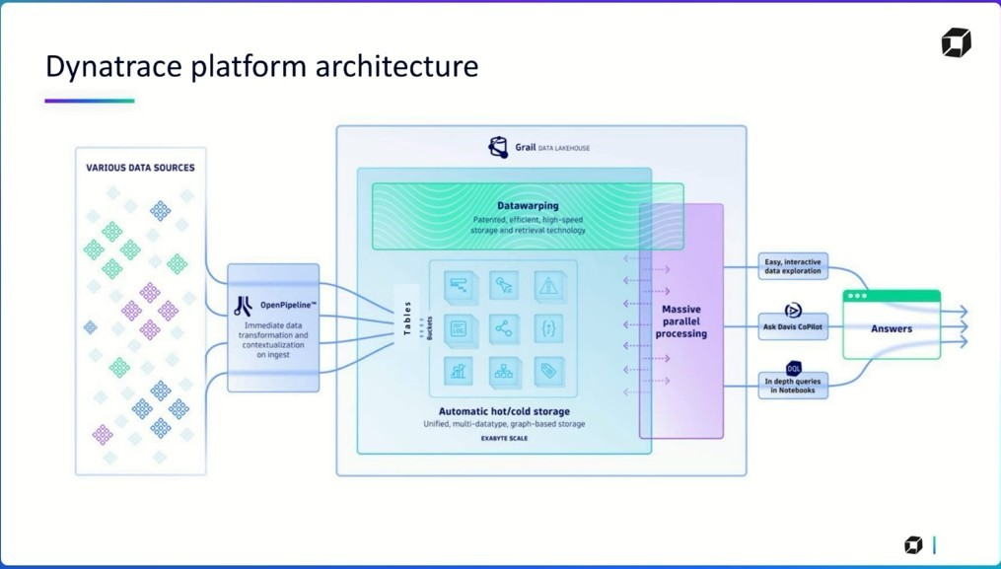
Notes:
"Let me walk you through the Dynatrace Platform Architecture and how OpenPipeline fits into the bigger picture.
We start on the left side — this represents various data sources. These can include logs, metrics, traces, business events, CI/CD pipeline data, and even third-party observability signals via OpenTelemetry, Fluent Bit, or custom APIs.
All of this data flows into OpenPipeline — which is the heart of Dynatrace's modern data ingestion strategy.
OpenPipeline isn’t just a pipe. It immediately transforms, normalizes, enriches, and masks the data as it arrives. Think of it as real-time, streaming ETL, optimized for exabyte-scale, high-throughput environments.
Once transformed, the data enters Grail, the platform's unified data lakehouse."

Slide 2
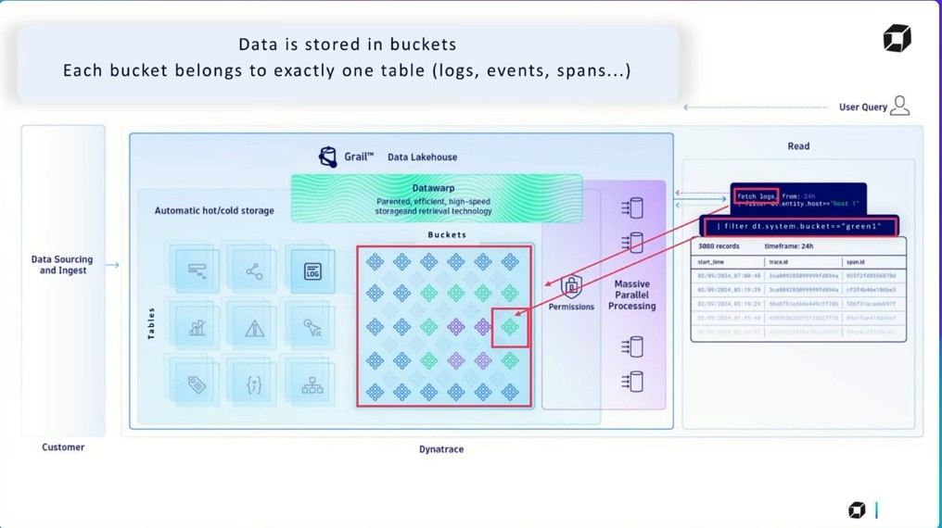
Notes:
🗣️ Speaking Notes (Slide Explanation)
"Now let’s take a closer look at how Grail stores and secures data — through a concept called Buckets.
👉 On the left, you can see that all ingested data — whether logs, metrics, traces, or events — flows into the Grail Data Lakehouse.
Within Grail, data is automatically categorized into tables based on their type — for example, log data goes into the 'log table', traces into the 'trace table', and so on.
📦 But within each table, data is further divided into Buckets.
Each bucket belongs to exactly one table and represents a logical unit of:
Retention policy
Access control
And even billing segmentation
This gives you incredible granularity and governance over your data."
🗣️ Speaking Notes (Permissions and Querying)
"Let’s now focus on the middle to right part of the diagram.
Notice how permissions are assigned at the bucket level. This means you can control:
Who sees what data
How long it's retained
Whether it’s queryable by certain users or teams
🔐 For example, logs from sensitive environments (like prod) can go to a restricted bucket only accessible to certain teams, while debug logs might be stored in a short-retention bucket.
On the far right, you see a user query. The user is running a Dynatrace Query Language (DQL) statement to:
Dql
fetch logs | filter dt.system.bucket == "green1"
That query will only return logs stored in the bucket labeled "green1" — based on both retention and permission settings.
This ensures high performance, privacy, and compliance, all while enabling parallel query processing on massive datasets."
✅ Key Takeaways
Data is split across tables by type and into buckets by retention and access rules.
Buckets control who can query what, for how long, and at what granularity.
Dynatrace enables bucket-level filtering using DQL, allowing for precision access and cost-effective data governance.

Slide 3
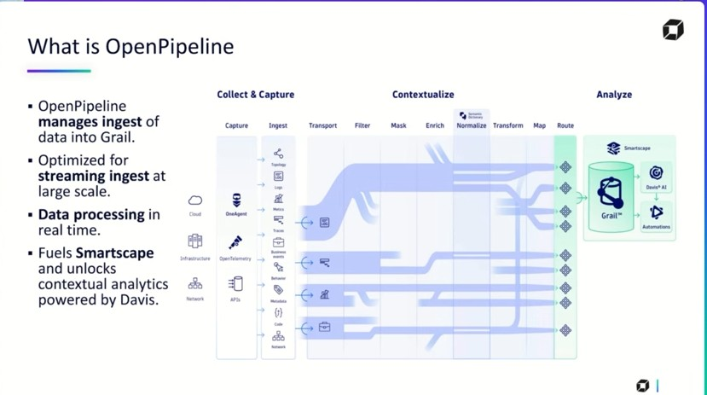
Notes:
🗣️ Speaking Notes
“Let’s take a closer look at what OpenPipeline actually is, and why it’s a key innovation within the Dynatrace platform.
🔹 At a high level, OpenPipeline is the ingestion and processing engine that feeds data into Grail, Dynatrace’s Data Lakehouse.
But it’s not just about collecting data — it’s about intelligent, high-speed, real-time processing on ingest.”
✅ Key Highlights from the Slide
🛠️ Collect & Capture
OpenPipeline supports data from cloud, infrastructure, network, and application sources.
Sources include OneAgent, APIs, OpenTelemetry, extensions, and more.
All of this data is captured and streamed directly into Dynatrace at scale.
⚙️ Contextualize OpenPipeline performs a rich set of data processing operations in real-time:
Transport: Pulls data from agents and APIs.
Filter: Removes irrelevant or duplicate data.
Mask: Protects sensitive fields (e.g., PII).
Enrich: Adds context like geo-location, team ownership, or Kubernetes metadata.
Normalize: Unifies diverse formats (e.g., syslog, JSON, logs) into a consistent schema.
Transform & Map: Converts raw data into structured values, extract metrics/events.
Route: Sends the cleaned-up data to specific buckets in Grail.
🔍 Analyze
Once in Grail, the data becomes queryable by:
Smartscape: For real-time service topology mapping.
Davis AI: For anomaly detection, problem correlation, and root cause analysis.
Automations: For triggering workflows, alerts, and remediation logic.
🔑 Talking Points to Emphasize
“OpenPipeline is not an afterthought — it is the gatekeeper of all observability data.”
“It is built for massive scale — think petabytes of data, processed in real time.”
“Its real value lies in enforcing enterprise-level governance, security, and cost optimization at ingest time — before anything even touches Grail.”

Slide 4
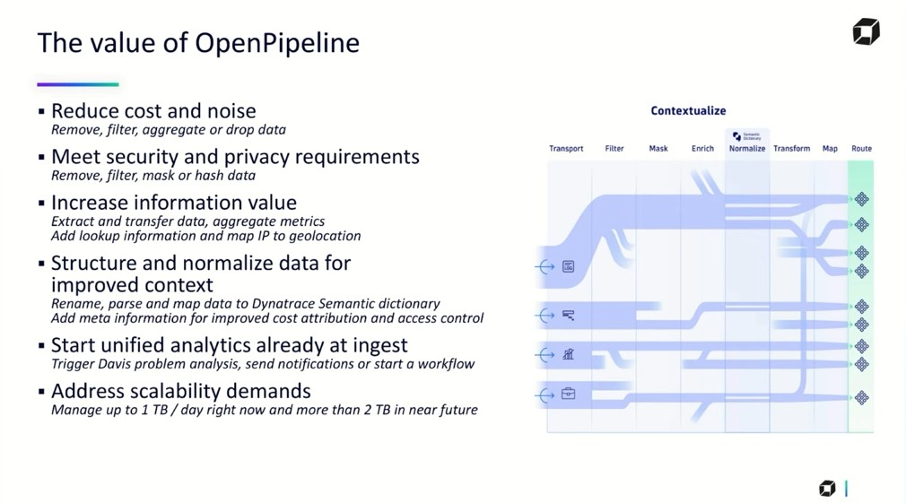
Notes:
🗣️ Speaking Notes
“As we see, It’s not just a data ingestion tool — it’s an enterprise-grade control plane for how data enters our observability system.”
✅ Key Benefits to Emphasize
📉 Reduce Cost and Noise
“We can remove, filter, or drop logs that are redundant, duplicated, or irrelevant.”
“This helps lower storage costs and removes clutter so teams can focus on high-value signals.”
🔐 Meet Security and Privacy Requirements
“Sensitive fields like emails, tokens, or PII can be masked or hashed on ingest.”
“This helps us stay compliant with privacy regulations like GDPR, HIPAA, etc.”
🔎 Increase Information Value
“We can enrich data with geo-location, organizational tags, or metadata.”
“This boosts its value for correlation, alerting, and business context — for example, mapping IPs to country codes.”
🧠 Structure and Normalize for Better Context
“OpenPipeline maps data into Dynatrace’s Semantic Dictionary, which aligns with Smartscape and DQL.”
“By doing so, we enable better cost attribution, access control, and improve AI-based analysis.”
⚡ Trigger Analytics at Ingest
“This is powerful — Davis AI can begin analyzing logs or metrics as they arrive.”
“We can also trigger alerts, send notifications, or even start automated workflows directly from ingest.”
📈 Address Scalability Demands
“OpenPipeline is built for streaming at scale — handling 1 TB/day now and scaling up to 2+ TB/day soon.”
“That’s enterprise-grade performance for high-velocity environments like cloud-native or financial platforms.”

Slide 5
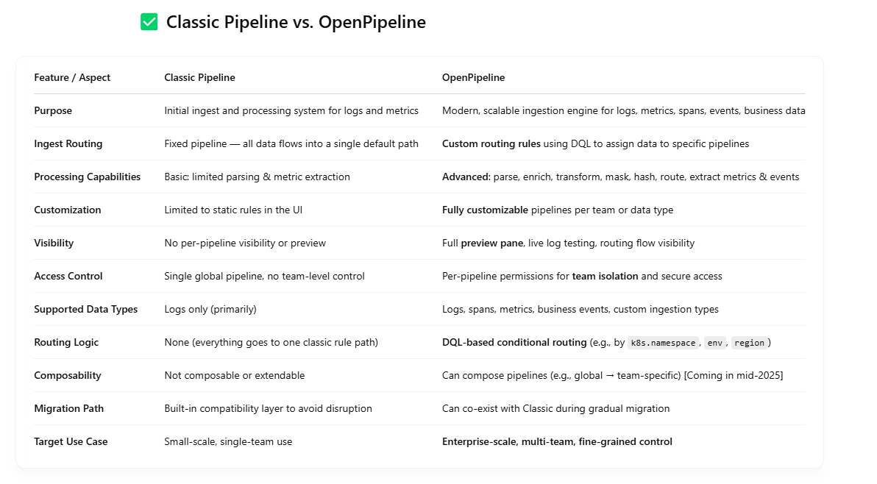

Slide 6
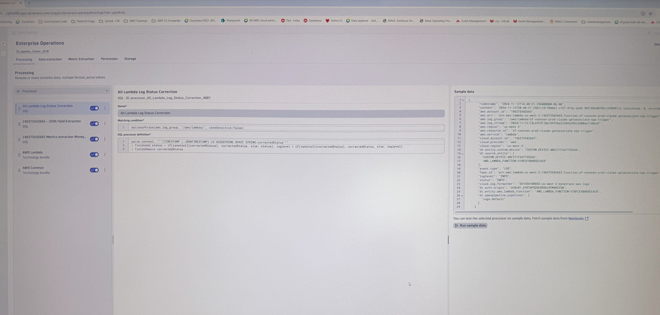
Notes:
A processing rule like this is extremely useful in real-world observability pipelines when your logs are inconsistent, embedded, or poorly structured, and you need to clean them up before they enter analytics and alerting systems like Dynatrace’s Grail.
Scenario
Why This Rule Helps
1. AWS Lambda Logs Embed Key Data in Raw Strings
Lambda logs often contain useful info (like statusCode, START, END, ERROR) only inside the content string — not in structured fields. You need to parse that manually.
2. Log Level or Status Is Missing or Incorrect
Sometimes logLevel or status fields are missing, null, or set to NONE. But they’re actually present inside the raw log message. This rule fixes that.
3. You're Ingesting Logs from Different Runtimes or Libraries
Logs coming from different Lambda functions or SDKs might have different formats. This rule creates a normalized format by overriding or adding fields like status or logLevel.
4. You Want Accurate Filtering or Alerting in DQL
If logLevel is set incorrectly (e.g., always "INFO"), you can’t write reliable DQL queries like filter logLevel == "ERROR". This rule makes those queries accurate.
5. You Want to Enable Davis AI to Catch Real Errors
Dynatrace Davis AI uses fields like logLevel and status. If these are incorrect or inconsistent, Davis may miss real issues. This rule ensures the right severity is available.
6. You Want to Mask or Route Data Based on Meaningful Status
If you want to drop, mask, enrich, or bucket logs based on status, it must first be extracted. This rule ensures you can act on the real intent of the log.
7. You Want to Avoid 'logLevel: NONE' Records in Dynatrace
Ingesting logs with logLevel: NONE pollutes the signal and shows up in parsing dashboards as a problem. This rule helps eliminate those.
🔍 Example Use Case
You have this raw Lambda log:
2024-11-12T08:48:21Z [INFO] requestId=... statusCode: 8, errorDescription: "Timeout"
Dynatrace might only pick up logLevel: INFO.
But statusCode: 8 actually indicates an error or timeout.
With the rule:
You extract correctedStatus = "8"
You set status = 8 and logLevel = 8
Downstream systems and queries now treat this log as a potential failure.
Understanding logLevel vs status
Field
Purpose
Typical Format
How It’s Used
logLevel
Represents severity of the log entry
INFO, ERROR, WARN, DEBUG, etc.
Used by Dynatrace for filtering, alerting, Davis AI analysis
status
Represents outcome of an operation
Can be numeric (e.g., 200, 500, 0, 8) or string (e.g., success, failure)
Used for logic, reporting, or business outcome tracking
🔹 logLevel – Common Values and Meaning
Log Level
Meaning
Use Case Example
DEBUG
Developer-level detail
Internal variable values or control flows
INFO
Normal operation
"User login succeeded"
WARN
Potential issue
"Memory usage exceeds 80%"
ERROR
Actual failure
"DB connection timeout"
FATAL
System crash imminent
"Kernel panic triggered"
NONE
Not detected or missing
Happens when logLevel is not parsed correctly
🔸 status – Common Values and Meaning
A. Numeric Status Codes (Typical in APIs, Lambda Logs)
Status
Meaning
Example Source
0
Success
exit code 0 in scripts or Lambda
1, 2
Warnings
CLI or OS return values
8
Timeout
AWS Lambda internal error
200
HTTP success
RESTful APIs
400
Bad request
User or input error
500
Server error
Infrastructure or backend failure
B. String-Based Status
Status
Meaning
Example Source
success
Operation completed
App logs
failure
Something went wrong
App logs
started, ended
Lifecycle stage
Lambda, containers
timeout
Took too long
Lambda, network logs
✅ Example Mapping in OpenPipeline
Let’s say your Lambda log says:
plaintext
CopyEdit
2024-11-12T08:48:21Z [INFO] statusCode: 8, errorDescription: "Timeout"
Before
After OpenPipeline Rule
logLevel: INFO
logLevel: ERROR (corrected from statusCode: 8)
status: null
status: 8
📌 Why This Distinction Matters
logLevel helps Dynatrace filter logs, trigger alerts, and correlate issues.
status helps applications and dashboards track outcomes or numerical results.
You can use both in DQL to fine-tune queries:
dql
CopyEdit
fetch logs | filter logLevel == "ERROR" and status == 8

Slide 7
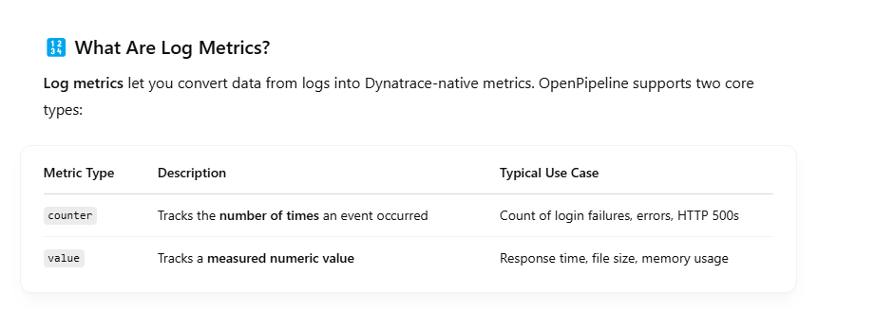
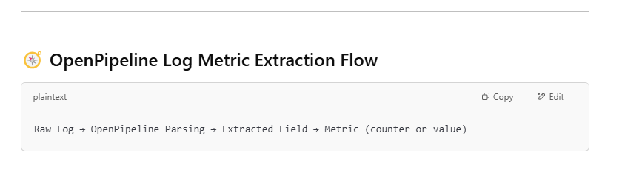

Slide 8
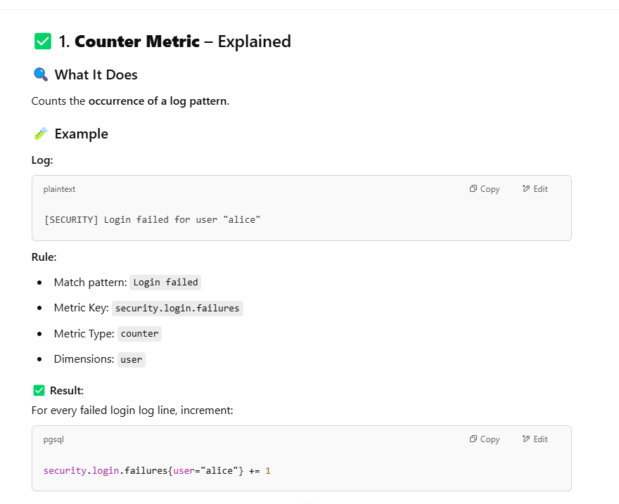

Slide 9
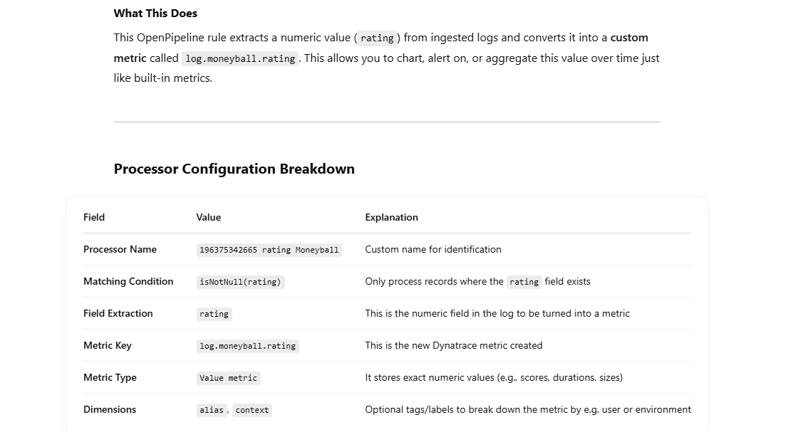

Slide 10
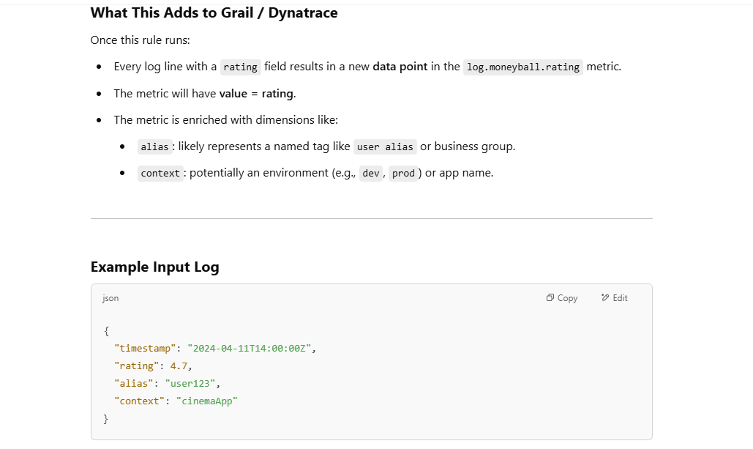

Slide 11
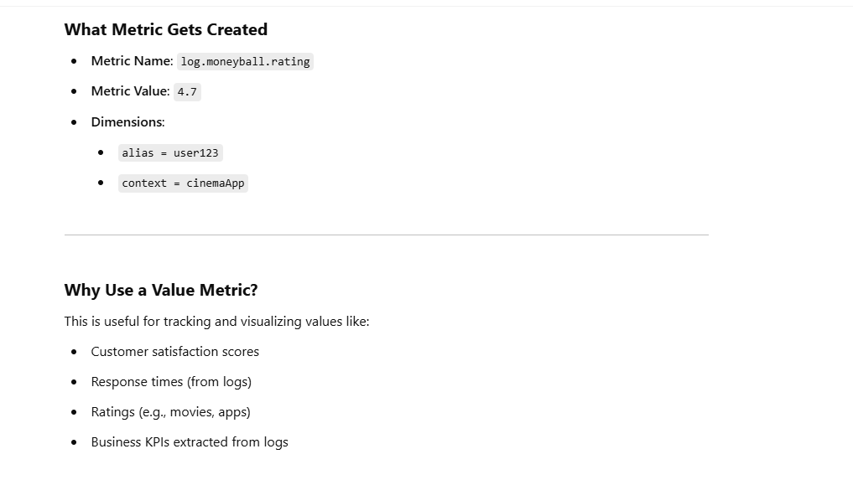
User
App

Slide 12
